Slide 1
Concrete Mixing
When water is added to dry material air void is removed. As a result volume of material shrinks.
Amount of Air Void in different materials
Shrinkage factor=air void in CA + air void in FA +1
=1+0.27+0.34=1.61
Material | Percent of Air Void
Sand | 20% to 27%
Cement
Coarse Aggregate | 32% to 34%

Slide 2
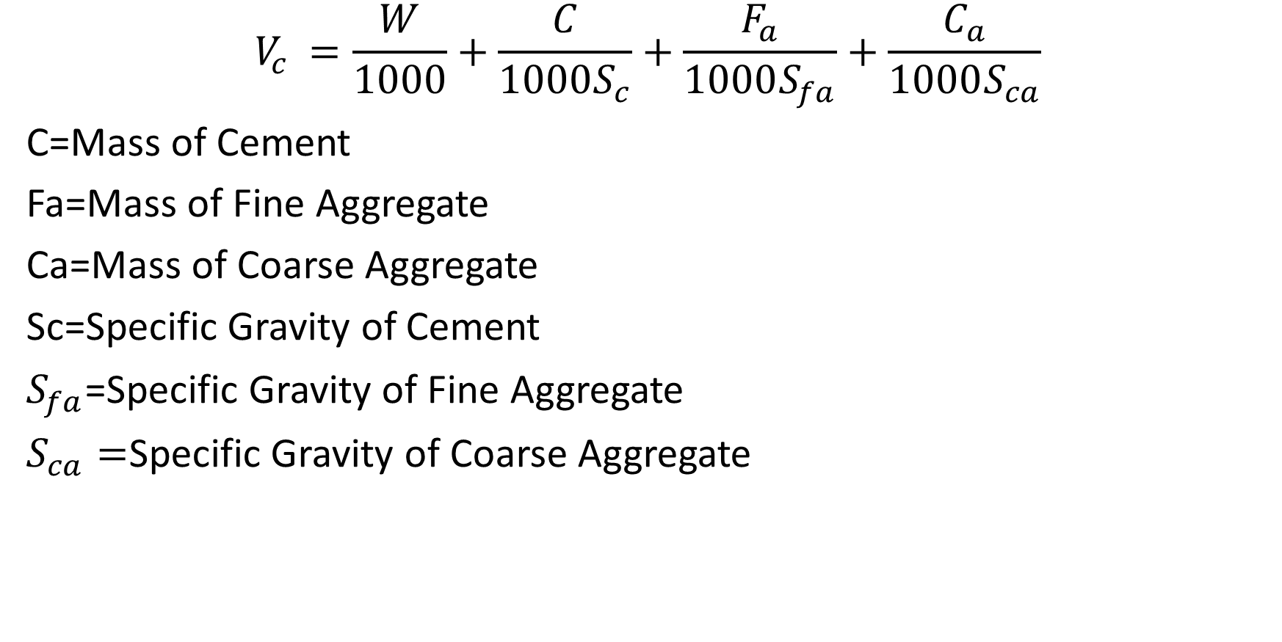
Concrete Materials from Finished Volume
$$V_{c }=\frac{W}{1000}+\frac{C}{1000S_{c}}+\frac{F_{a}}{1000S_{fa}}+\frac{C_{a}}{1000S_{ca}}$$
C=Mass of Cement
Fa=Mass of Fine Aggregate
Ca=Mass of Coarse Aggregate
Sc=Specific Gravity of Cement
$S_{fa}$=Specific Gravity of Fine Aggregate
$S_{ca}=$Specific Gravity of Coarse Aggregate

Slide 3
Steps of Calculation Steps

